Slide 1

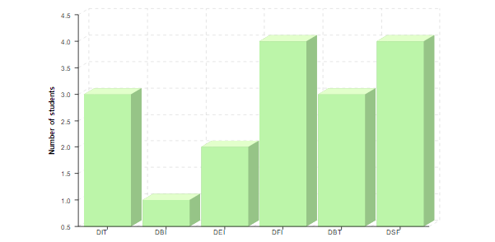
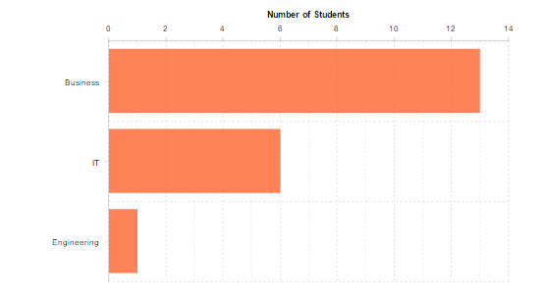
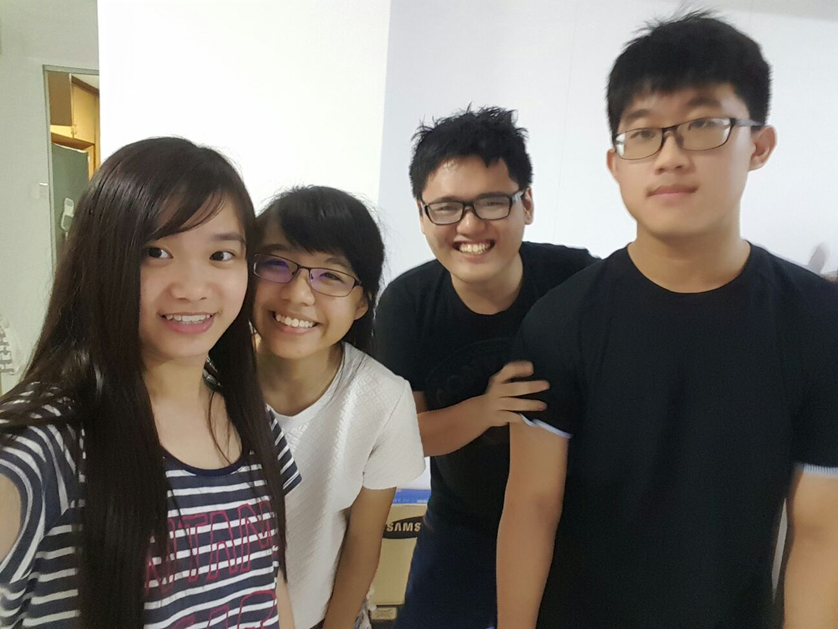
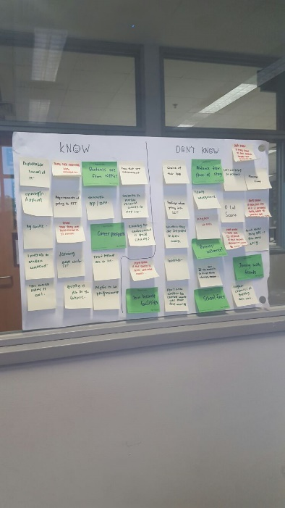
PURE INSANITY
THE IDEA
Graph 5 : Number of students motivated by course relevance to their future careers
The first graph under course relevance shows the number of students from each diploma who are motivated to join NYPSIT because of course relevance . We have chose to display these results that we collected into bar graphs as we wanted to show the number of students from each diploma who joined NYPSIT due to courses’ relevancy for their future career .
Graph 6 : Students interested in different field of studies under SIT
The second graph under course relevance shows the number of students interested in the various field of studies . We have chose to display our results that we collected in bar chart form so as to show the difference in popularity between the three fields of study amongst students.
HOW THE IDEAS ARE GENERATED
Group Members:
Tan Jun Long (151176T)
Aaw Aun Yeow (152899E)
Mabel Gan Wan Tian (151477X)
Chong Yan Qing (154466H)
Design thinking affects the way our ideas flow and ultimately, affects the way our application look. Design thinking is a crucial process as it determines how our app works and looks according to a user’s perspective.
Our ideas were generated using the Design Thinking Process which were introduced to us. At first, we gathered questions to ask based on the objective of our project, which is to find out what motivates Year 1 students to join NYPSIT. Using the results, we started putting them into graphs based on the 4 main topics which motivated Year 1 students to join NYPSIT, namely Interest, Motivation, Course Relevance and lastly, Career. Slowly, we came up with a sketch of how we want our application to appear to the users. We did change improve our layout overtime as we added more features to our dashboard. Eventually, we came up with the perfect application for users to use.

